Slide 1
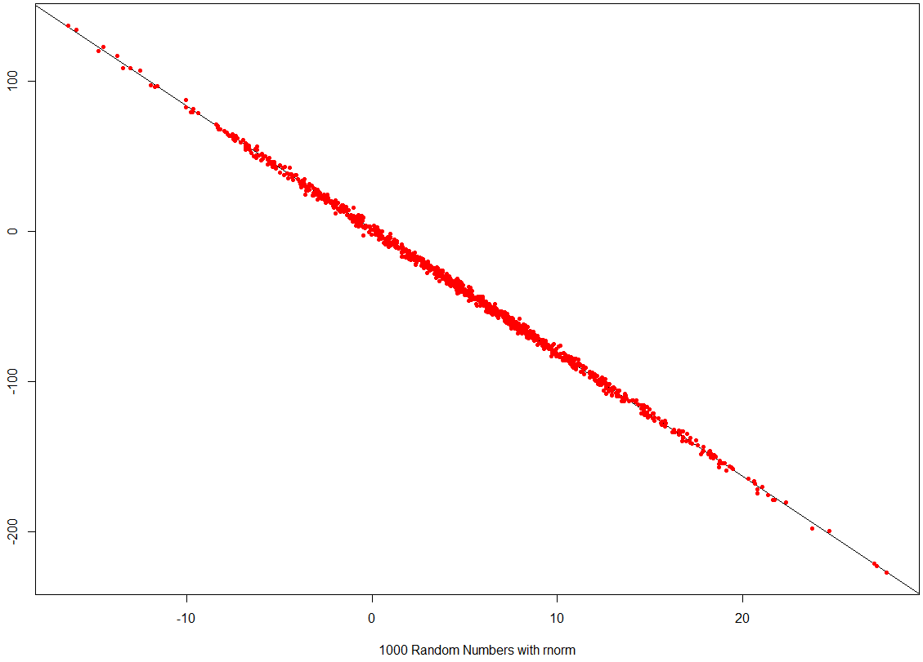
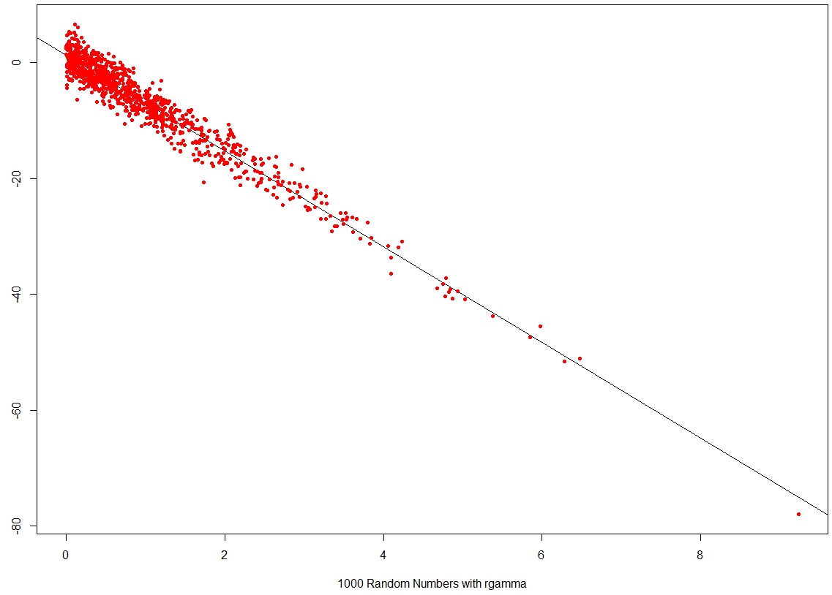
#Simulating fake random normal data
x_1 <- rnorm(1000,5,7) #1000 Random numbers mean 5 and standard deviation of 7
#Simulate gamma distrubation
x_2 <- rgamma (n = 1000, shape = 1, scale = 1)
#Plot data
hist(x_1, col = "gray") #plot p(x)
hist(x_2, col = "blue") #plot p(x)
true_error <- rnorm(1000,0,2)
true_beta_0 <- 1.1
#true_beta_0 <- 3.1
true_beta_1 <- -8.2
#true_beta_1 <- 7.3
true_beta_2 <- 6.5
y_1 <- true_beta_0 + true_beta_1*x_1 + true_error
hist(y_1) #plot p(y_1)
plot(x_1,y_1, pch=20, col= "red", xlab = "1000 Random Numbers with rnorm",
ylab = "Y_1", abline(lm(y_1 ~ x_1))) #plot p(x,y)
#using gamma distrubation
y_2 <- true_beta_0 + true_beta_1*x_2 + true_error
hist(y_2) #plot p(y_2)
plot(x_2,y_2, pch=20, col= "red", xlab = "1000 Random Numbers with rgamma",
ylab = "Y_2", abline(lm(y_2 ~ x_2))) #plot p(x,y)
Call:
lm(formula = y_1 ~ x_1)
Coefficients:
(Intercept) x_1
1.140 -8.192
true_beta_0 <- 1.1
true_beta_1 <- -8.2
Call:
lm(formula = y_2 ~ x_2)
Coefficients:
(Intercept) x_2
1.233 -8.252

Slide 2
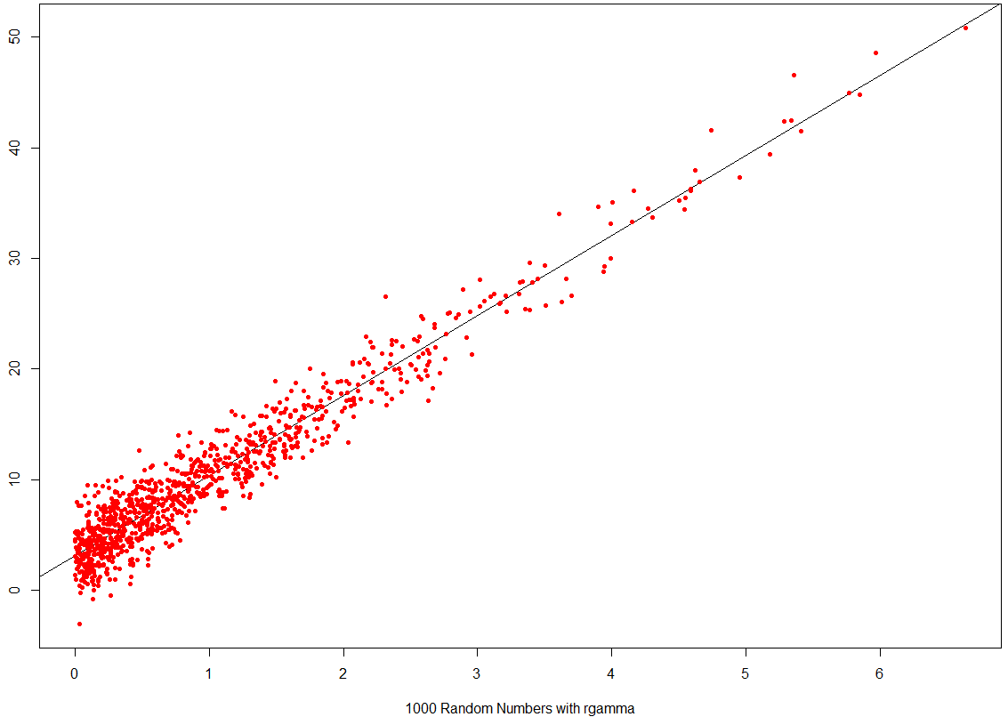
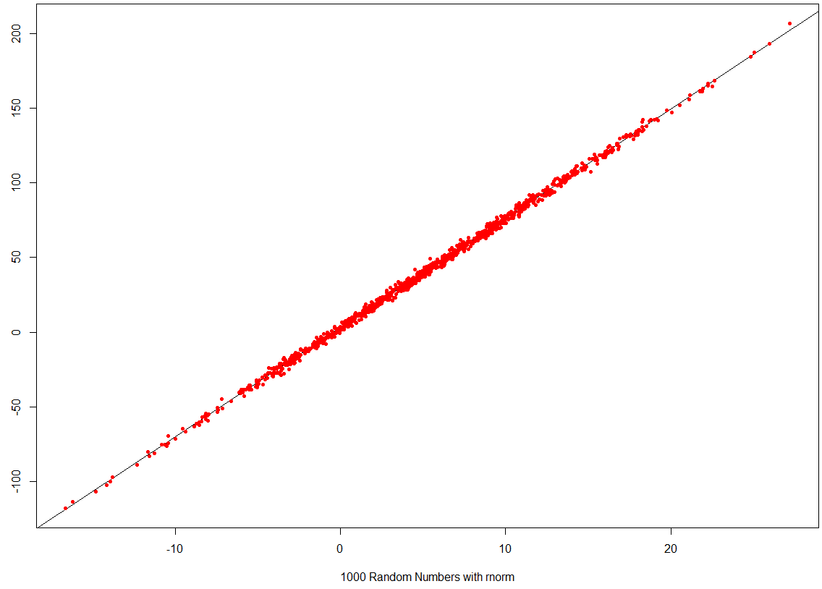
#Simulating fake random normal data
x_1 <- rnorm(1000,5,7) #1000 Random numbers mean 5 and standard deviation of 7
#Simulate gamma distrubation
x_2 <- rgamma (n = 1000, shape = 1, scale = 1)
#Plot data
hist(x_1, col = "gray") #plot p(x)
hist(x_2, col = "blue") #plot p(x)
true_error <- rnorm(1000,0,2)
#true_beta_0 <- 1.1
true_beta_0 <- 3.1
#true_beta_1 <- -8.2
true_beta_1 <- 7.3
true_beta_2 <- 6.5
y_1 <- true_beta_0 + true_beta_1*x_1 + true_error
hist(y_1) #plot p(y_1)
plot(x_1,y_1, pch=20, col= "red", xlab = "1000 Random Numbers with rnorm",
ylab = "Y_1", abline(lm(y_1 ~ x_1))) #plot p(x,y)
#using gamma distrubation
y_2 <- true_beta_0 + true_beta_1*x_2 + true_error
hist(y_2) #plot p(y_2)
plot(x_2,y_2, pch=20, col= "red", xlab = "1000 Random Numbers with rgamma",
ylab = "Y_2", abline(lm(y_2 ~ x_2))) #plot p(x,y)
Call:
lm(formula = y_2 ~ x_2)
Coefficients:
(Intercept) x_2
3.023 7.315
true_beta_0 <- 3.1
true_beta_1 <- 7.3
Call:
lm(formula = y_1 ~ x_1)
Coefficients:
(Intercept) x_1
3.036 7.300

